Slide 1

Genetic Schedule Picker

Slide 2
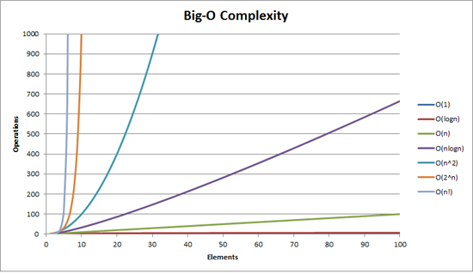
Problem Overview
Order n number of mentees into groups with m number of mentors
Problem is NP-Complete
Running time of naïve algorithm is O(k!) where k is the number of groups to be scheduled [1]
For this problem k = n/m
Additional Considerations
Features?
Transfer Students?
Online Only?
PreDent/PrePA/etc.
[1] Christophe Lenté, Mathieu Liedloff, Ameur Soukhal, Vincent t’Kindt. Exponential Algorithms for Scheduling Problems. 2014. hal-00944382
[2] https://medium.com/@lauren.kroner/understanding-big-o-notation-61ba6dbb2215

Slide 3
Proposed Solution: Genetic Algorithm
Heuristic approach to cut down search space
Based off Darwin’s theory of evolution
Each Generation is trying to maximize a fitness function

Slide 4
Fitness Function
Fitness Function for this program looks at the following parameters
Group Size
Unmatched People (Mentors and Mentees)
Num Groups
Feature Score

Slide 5
Algorithm Walkthrough
Initial Chromosomes (Groups)
Generation 1
..
..
…
…
..

Slide 6
Algorithm Walkthrough (PRUNE)
Initial Chromosomes (Groups)
Generation 1
..
..
…
…
..

Slide 7
Algorithm Walkthrough
Generation 2
Initial Chromosomes (Groups)
Generation 1
..
..
…
…
..

Slide 8
Bad News ☹
The optimal solution is not guaranteed
Accuracy is traded for speed
The optimal weights for the fitness function will change with the dataset and parameters

Slide 9
Good News :D
A “pretty good” solution is found
Much much faster than exponential time (polynomial time instead of exponential)
Parameters and arguments are customizable
Group generated from the program are guaranteed to be accurate

Slide 10
Running the Program

Slide 11
Required Dependencies
Python 3
Default installation should be good enough

Slide 12
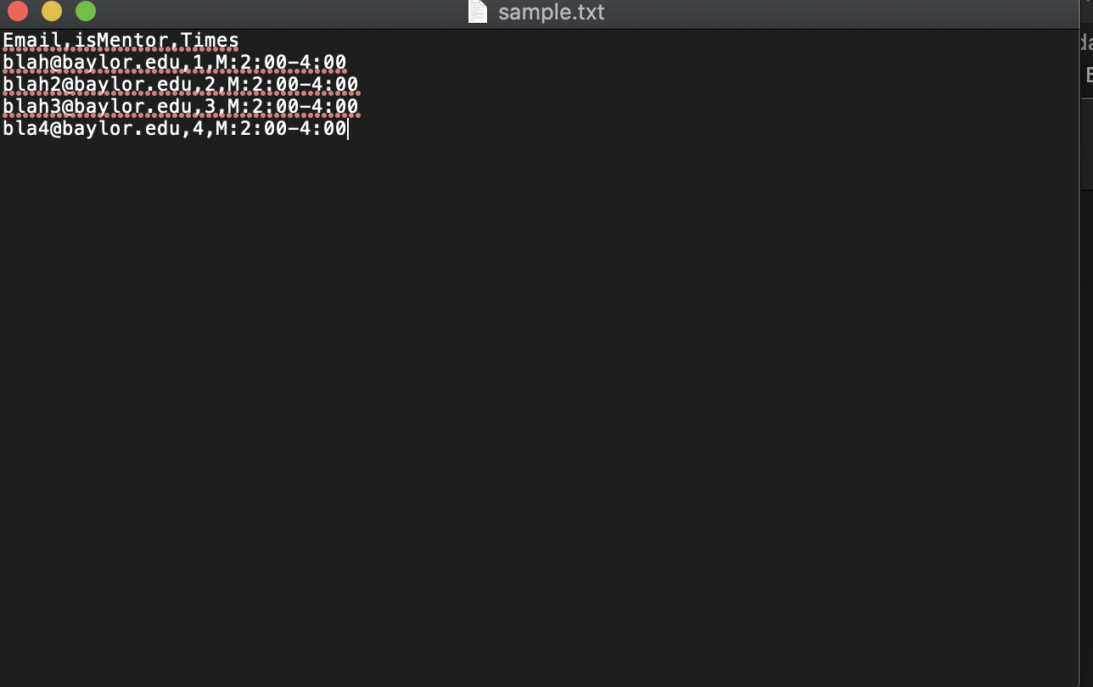
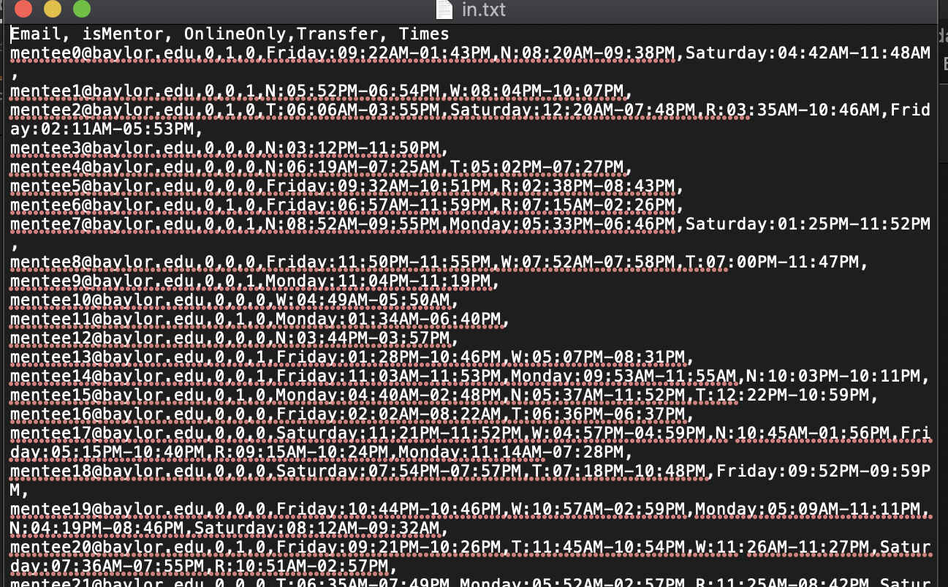
Input
Input data must be in a csv file
Required fields: Email, isMentor, Times
Optional fields (used for features): must be binary values placed before Times
Times must be in the following format: <Day of the week>:Time-Time

Slide 13
Running the Program
Basic running can be achieved by following command
python3 main.py –input_file <filename>
Full list of commands can be found by following command
python3 main.py –h

Slide 14
Select Parameters
--meeting_duration (defaults to 75)
--sample_size
The number of chromosomes randomly selected for the next generation (pre-prune stage)
--unmatched_weight/ --group_size_weight/ --num_groups_weight/ --feature_weight
Weights for the 4 parts of the fitness function. Total amongst these arguments must equal 1

Slide 15
Output
Groups file is written to groups.csv (can be opened in excel)
Unmatched people is written to unmatched.csv (can be opened in excel)

Slide 16
Additional Features
Email functionality in emailer.py
Able to be accessed through main.py or by running python3 emailer.py
Need to provide Gmail credentials in a config.txt file
Reads from groups.csv
Data Generation/Cleaning in datagen.py
Has some functions to either generate random data or convert data to proper format.

